Slide 1
A WARM HEARTED, HOLY SPIRIT INSPIRED CHURCH

Slide 2
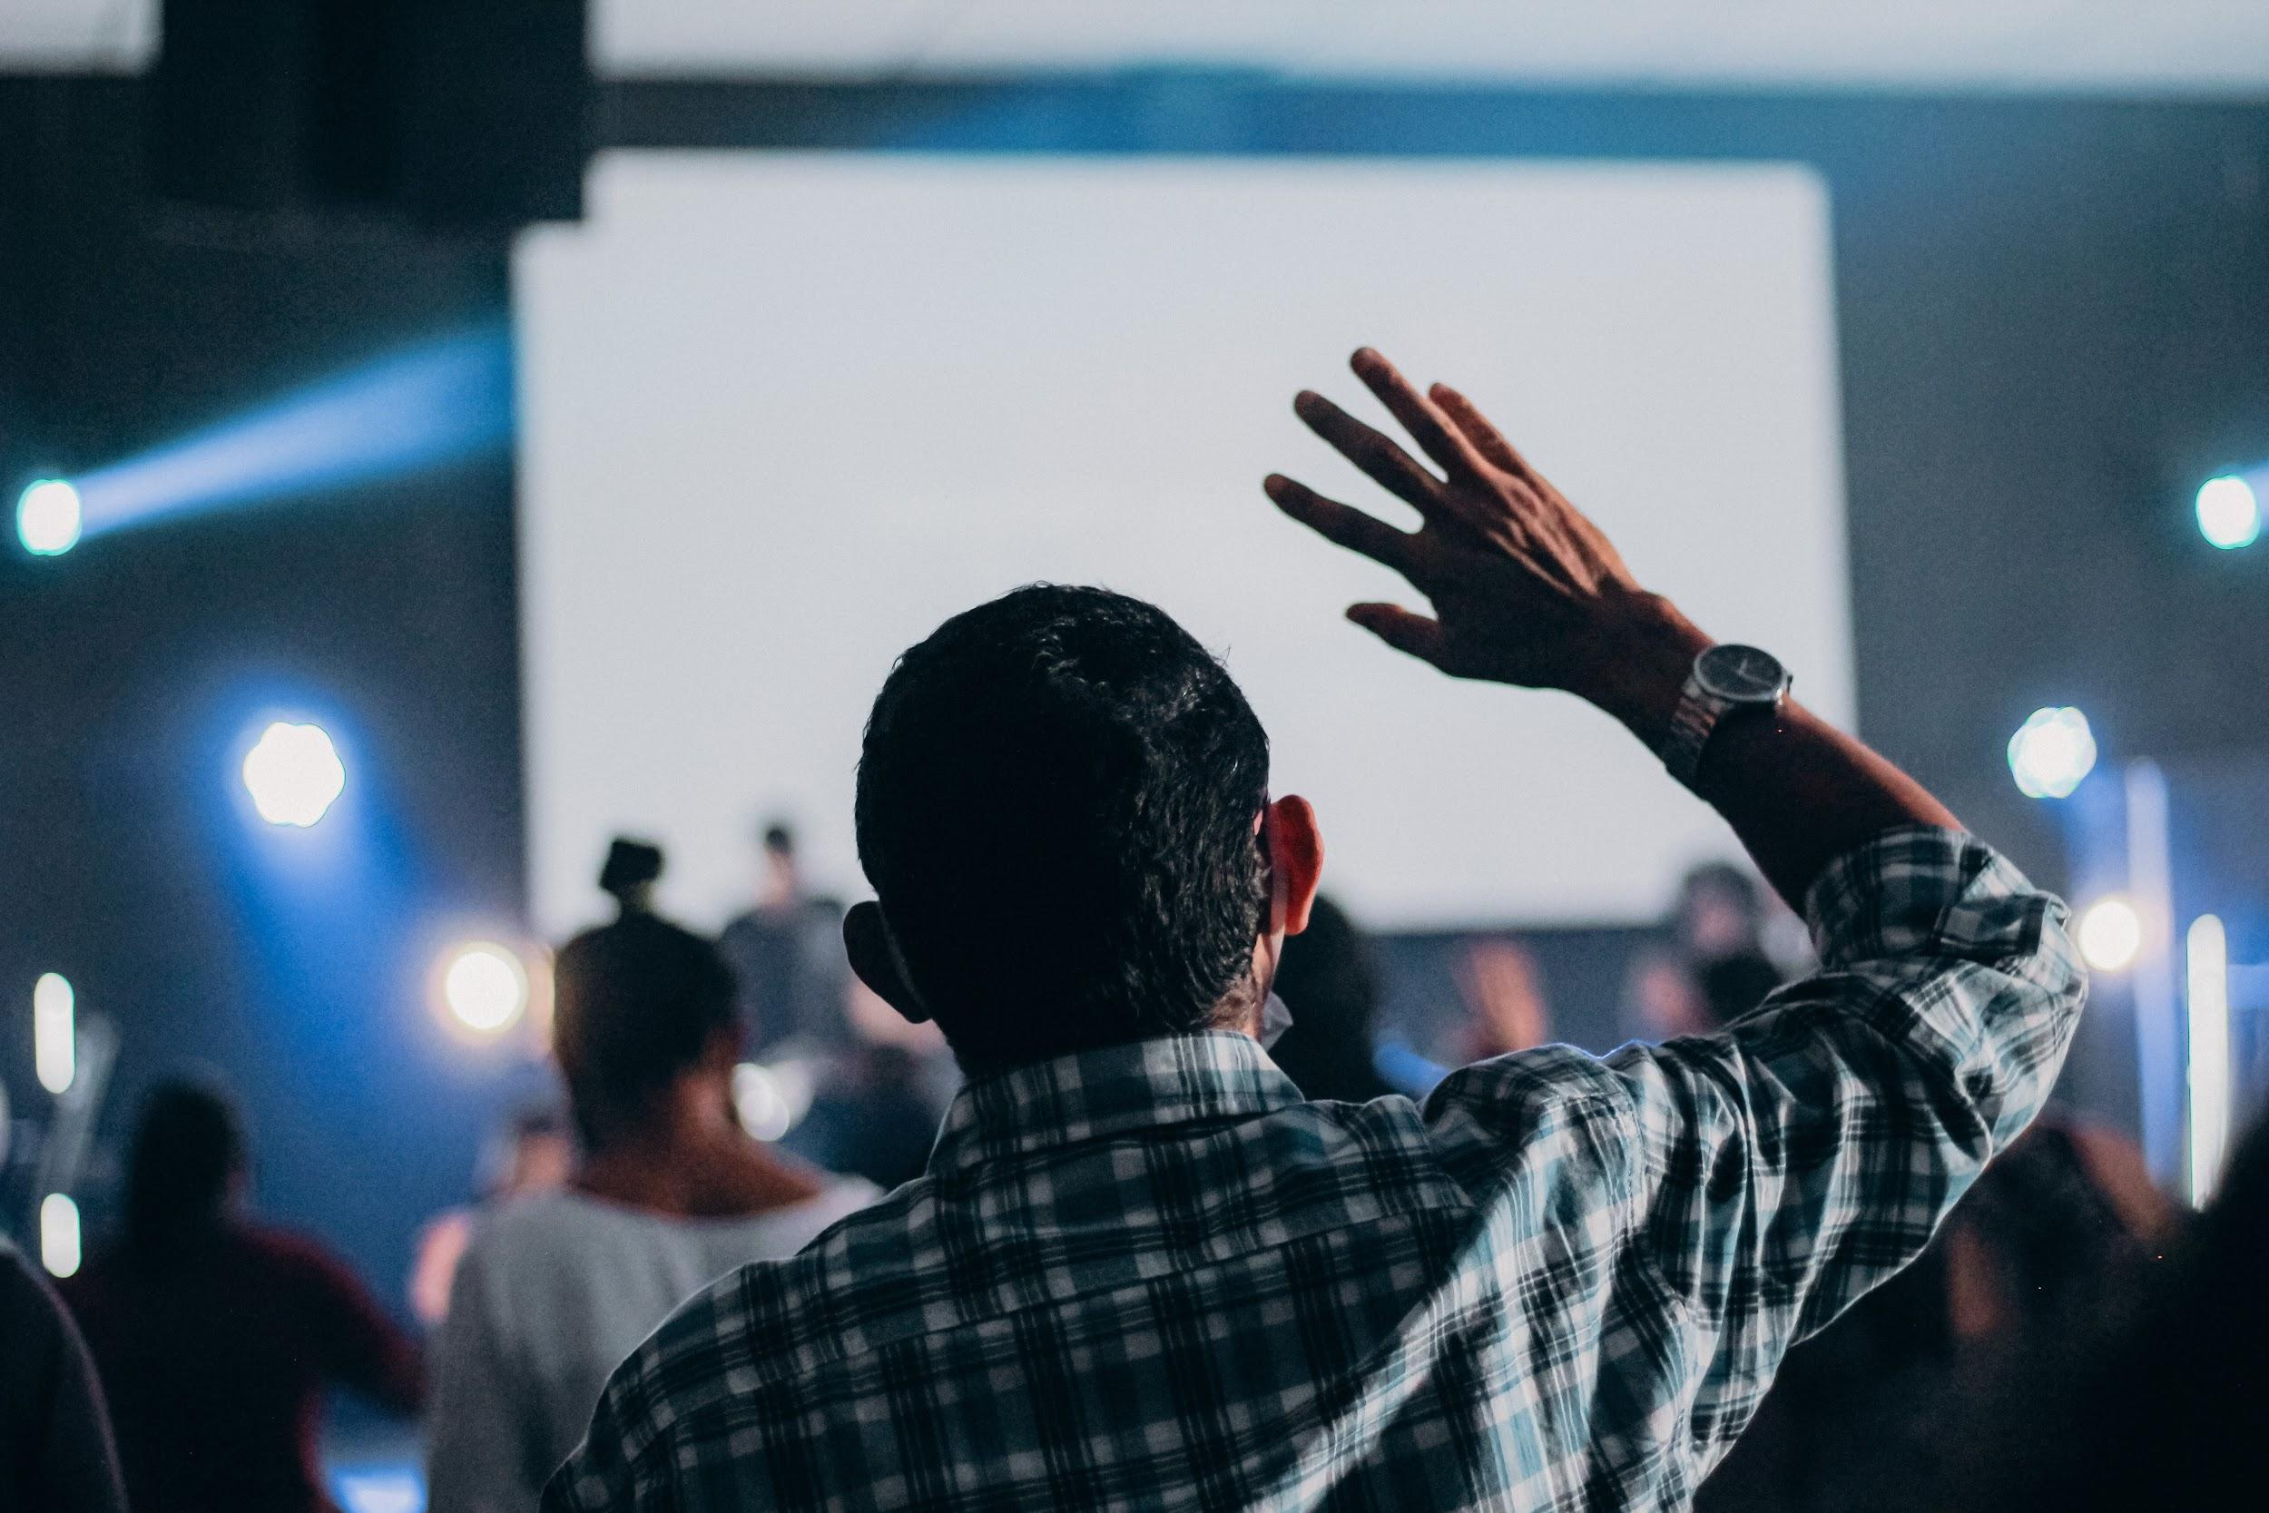
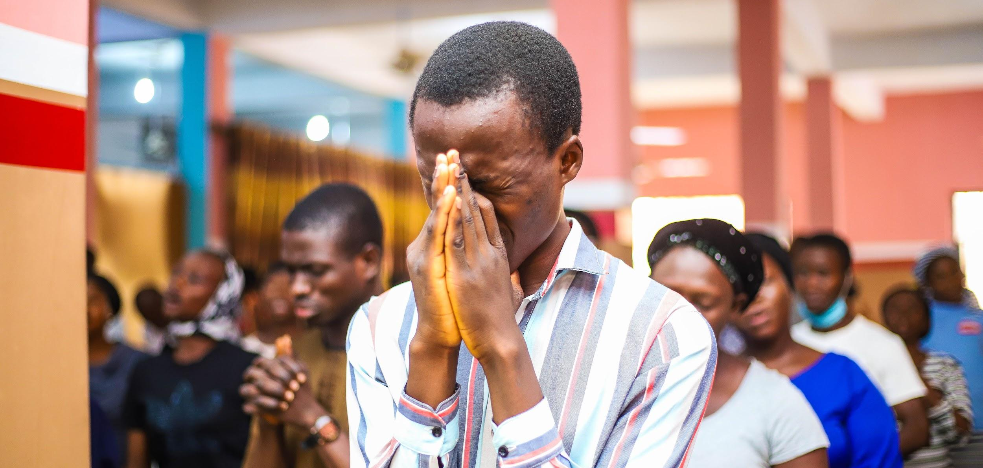
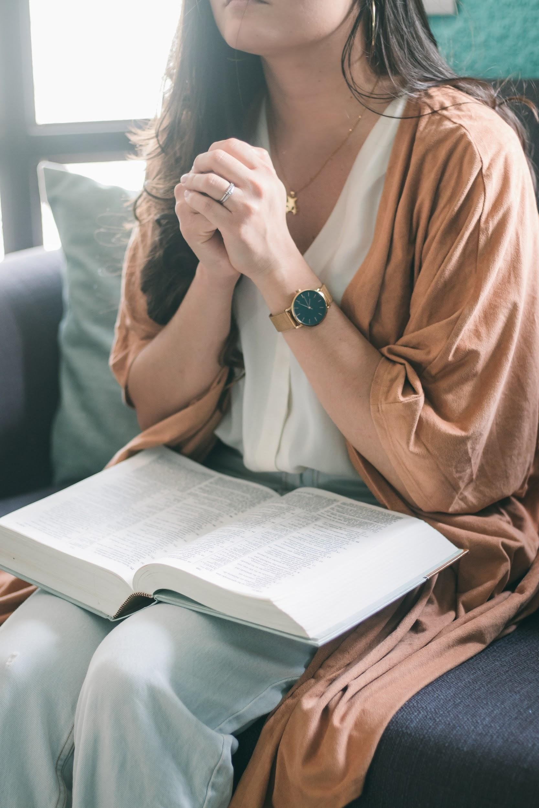
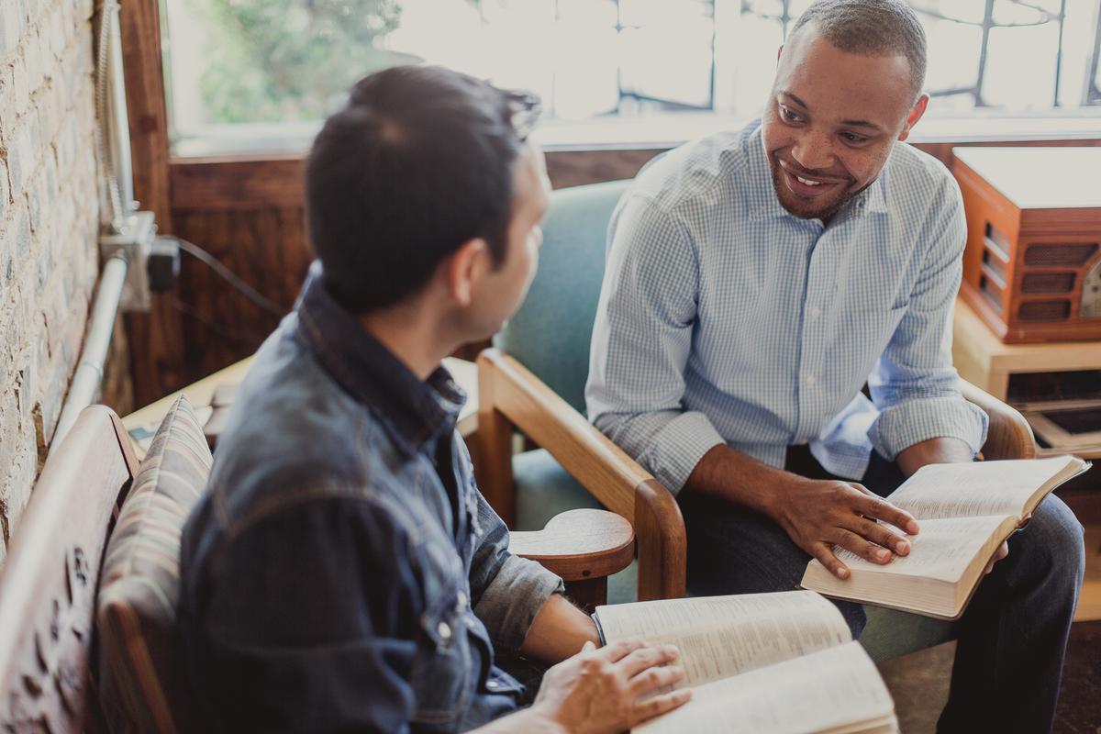
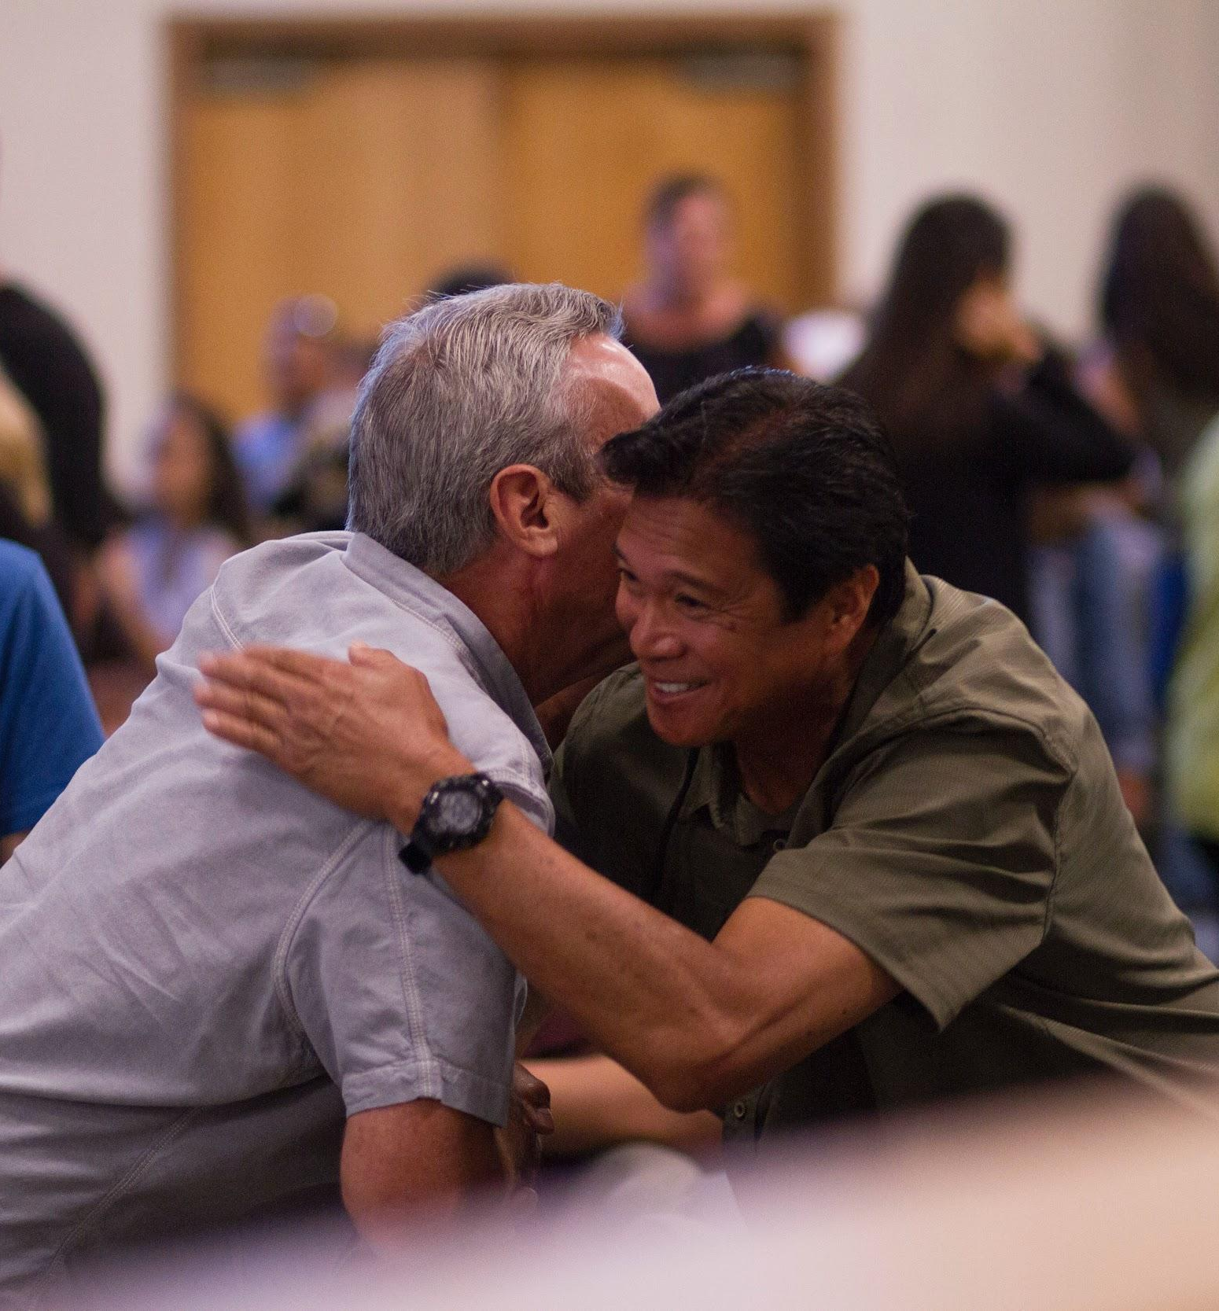
FOR ALL GOD’S PEOPLE

Slide 3
OUR MISSION
To make disciples of Jesus Christ who worship passionately, love extravagantly, and witness boldly.

Slide 4
OUR VISION
To join God in a journey of bringing new life, reconciliation, and the presence of Christ to all people, and to helping each person reflect the character of Christ.

Slide 5
NEW BEGINNING
With humility, hope, and joy, the 17- member body known as the Transitional Leadership Council announced the official launch of the Global Methodist Church as of May 1, 2022.
Notes:
Thousands of Methodist clergy and laity from around the world worked together to lay the groundwork for a new, theologically conservative Methodist denomination steeped in the great ecumenical and evangelical confessions of the Christian faith. They envision a church fired by a warm hearted, Wesleyan expression of that faith that is dedicated to sharing the Good News of Jesus Christ in word and deed.

Slide 6
CORE CONFESSIONS
The Global Methodist Church professes the Christian faith, established on the confession of Jesus as messiah, the Son of God, and resurrected Lord of heaven and earth.
Notes:
This confession, expressed by Simon Peter in Matthew 16:16-19 and Acts 2:32, is foundational. It declares Jesus is the unique incarnate Word of God, and He lives today, calling all to receive Him as savior, and as the one to whom all authority has been given. This faith has been tested and proved since its proclamation by Mary Magdalene, the first witness to the resurrection. It was defended by the women and men of the early church, many of whom gave their lives as testimony. Their labor, enabled and inspired by the Holy Spirit, resulted in the canon of scripture as the sufficient rule both for faith and practice. It formulated creeds such as the Apostles’ Creed, and the Nicene Creed as accurate expressions of this faith.

Slide 7
ALL GOD’S PEOPLE
By virtue of its very name, the Global Methodist Church is a diverse church where all God’s people – whatever their color, culture, ethnicity, or nationality – are warmly welcomed to join with others to make disciples of Jesus Christ who worship passionately, love extravagantly, and witness boldly.
Notes:
It is a body that recognizes and deploys the gifts and contributions of each part of the church, working as partners in the Gospel with equal voice and leadership. The Global Methodist Church’s witness to the world is marked by mutual love, concern, sharing, and a focus on those who are most vulnerable. Its members watch over one another in love and bear witness to the transforming power of the Gospel as we humbly, but boldly, strive to serve others as ambassadors of Christ!

Slide 8
WOMEN IN MINISTRY
The Global Methodist Church celebrates and praises God for the gifts women bring to all levels of the church. There are no barriers to where they can serve in the church.
Notes:
Women are joyfully received as members in local churches where they serve as trustees, lay leaders, and Sunday school teachers, among many other roles. They are also joyfully ordained as elders and deacons, and consecrated as bishops. The Global Methodist Church believes Scripture and Christian tradition bear witness to the importance of women and men sharing the responsibility and joy of serving the church.

Slide 9
METHODIST DISTINCTIVES
The Global Methodist Church is for all people who wish to join in a “methodical,” practical, and warm-hearted pursuit of loving God and serving others as Jesus’ disciples in the world.
Notes:
Through the organization and published works of John and Charles Wesley, the Methodist movement’s founders, a distinctly Methodist articulation of Christian faith and life was developed. Methodism placed particular emphasis on the universal work of grace, the new birth, and the fullness of salvation. The movement set as its mission: “to reform the nation, especially the church, and spread scriptural holiness over the land.”

Slide 10
ORGANIZATIONAL DISTINCTIVE
The Global Methodist Church is a connection of the willing not the constrained. In short, there is no “trust clause” as there is in some other denominations stating that a local church merely holds property and assets in trust for a general church. Instead, local Global Methodist congregations own all of their property and assets in perpetuity.
Notes:
As long as a local church wants to be part of the connection it is welcome in the Global Methodist Church. The Global Methodist Church encourages congregations to be innovative and nimble as they work to fulfill the church’s mission at the grassroots level. They are not asked to serve a large bureaucratic general church with multiple boards and agencies. Rather, a light general church is structured so it serves and resources local churches. The whole church focuses on creative ways to share the timeless message of the Gospel for the world we all live in today.

Slide 11
BISHOPS LEADERSHIP
From apostolic times, certain ordained persons have been set apart and entrusted with the task of defending the Apostolic faith and overseeing and leading the church in its mission to make disciples of Jesus Christ and to spread scriptural holiness around the world. The role of a bishop is a sacred trust held for a defined period of time; it is not a lifelong office.
Notes:
The Global Methodist Church is led, equipped, and supervised by an episcopacy modeled after that of the early centuries of Christianity and stemming from the historic line of Methodist bishops.
We share John Wesley’s conviction that bishops and elders are part of the same New Testament order.

Slide 12
JOYFUL DISCIPLESHIP
The Global Methodist Church believes people have a deep desire to know the truth, and to devote themselves to it wholeheartedly. Our Church believes Jesus is the Truth, and he calls us to be his disciples.
Notes:
Through Christ’s infinite grace and by the power of the Holy Spirit, we are free to embark on a path of joyful obedience to God’s calling on our lives. Fortunately, we walk together as Jesus’ disciples. And in doing so we challenge one another to give our hearts, minds, souls, and bodies to the endeavor of growing in the faith. Every Global Methodist church calls all its members – from the very young to the very old – to participate in classes to study Scripture, to learn about the richness of the Christian faith, and how to winsomely share it with others.

Slide 13
ACCOUNTABLE DISCIPLESHIP
From its inception, the Methodist movement embraced the importance and power of small groups where people gave themselves over to accountable discipleship. The Global Methodist Church is strongly committed to recapturing this method for growing faithful disciples.
Notes:
The Church calls all its members to robust, life-long faith formation; faith formation that involves participation in small groups where disciples hold one another accountable with truth and grace as they continue to grow as Jesus’ joyful and obedient disciples.

Slide 14
www.globalmethodist.org

